Slide 1

Group G51
i
Team Members
Gunjit Dalal (L)
Arun Kumar
Vishal Sahu

Slide 2


Medes App
i
We are always ready to help you

Slide 3

Why we need this application?
To Provide fast Service
To find nearest test center
To save your Time and Money

Slide 4
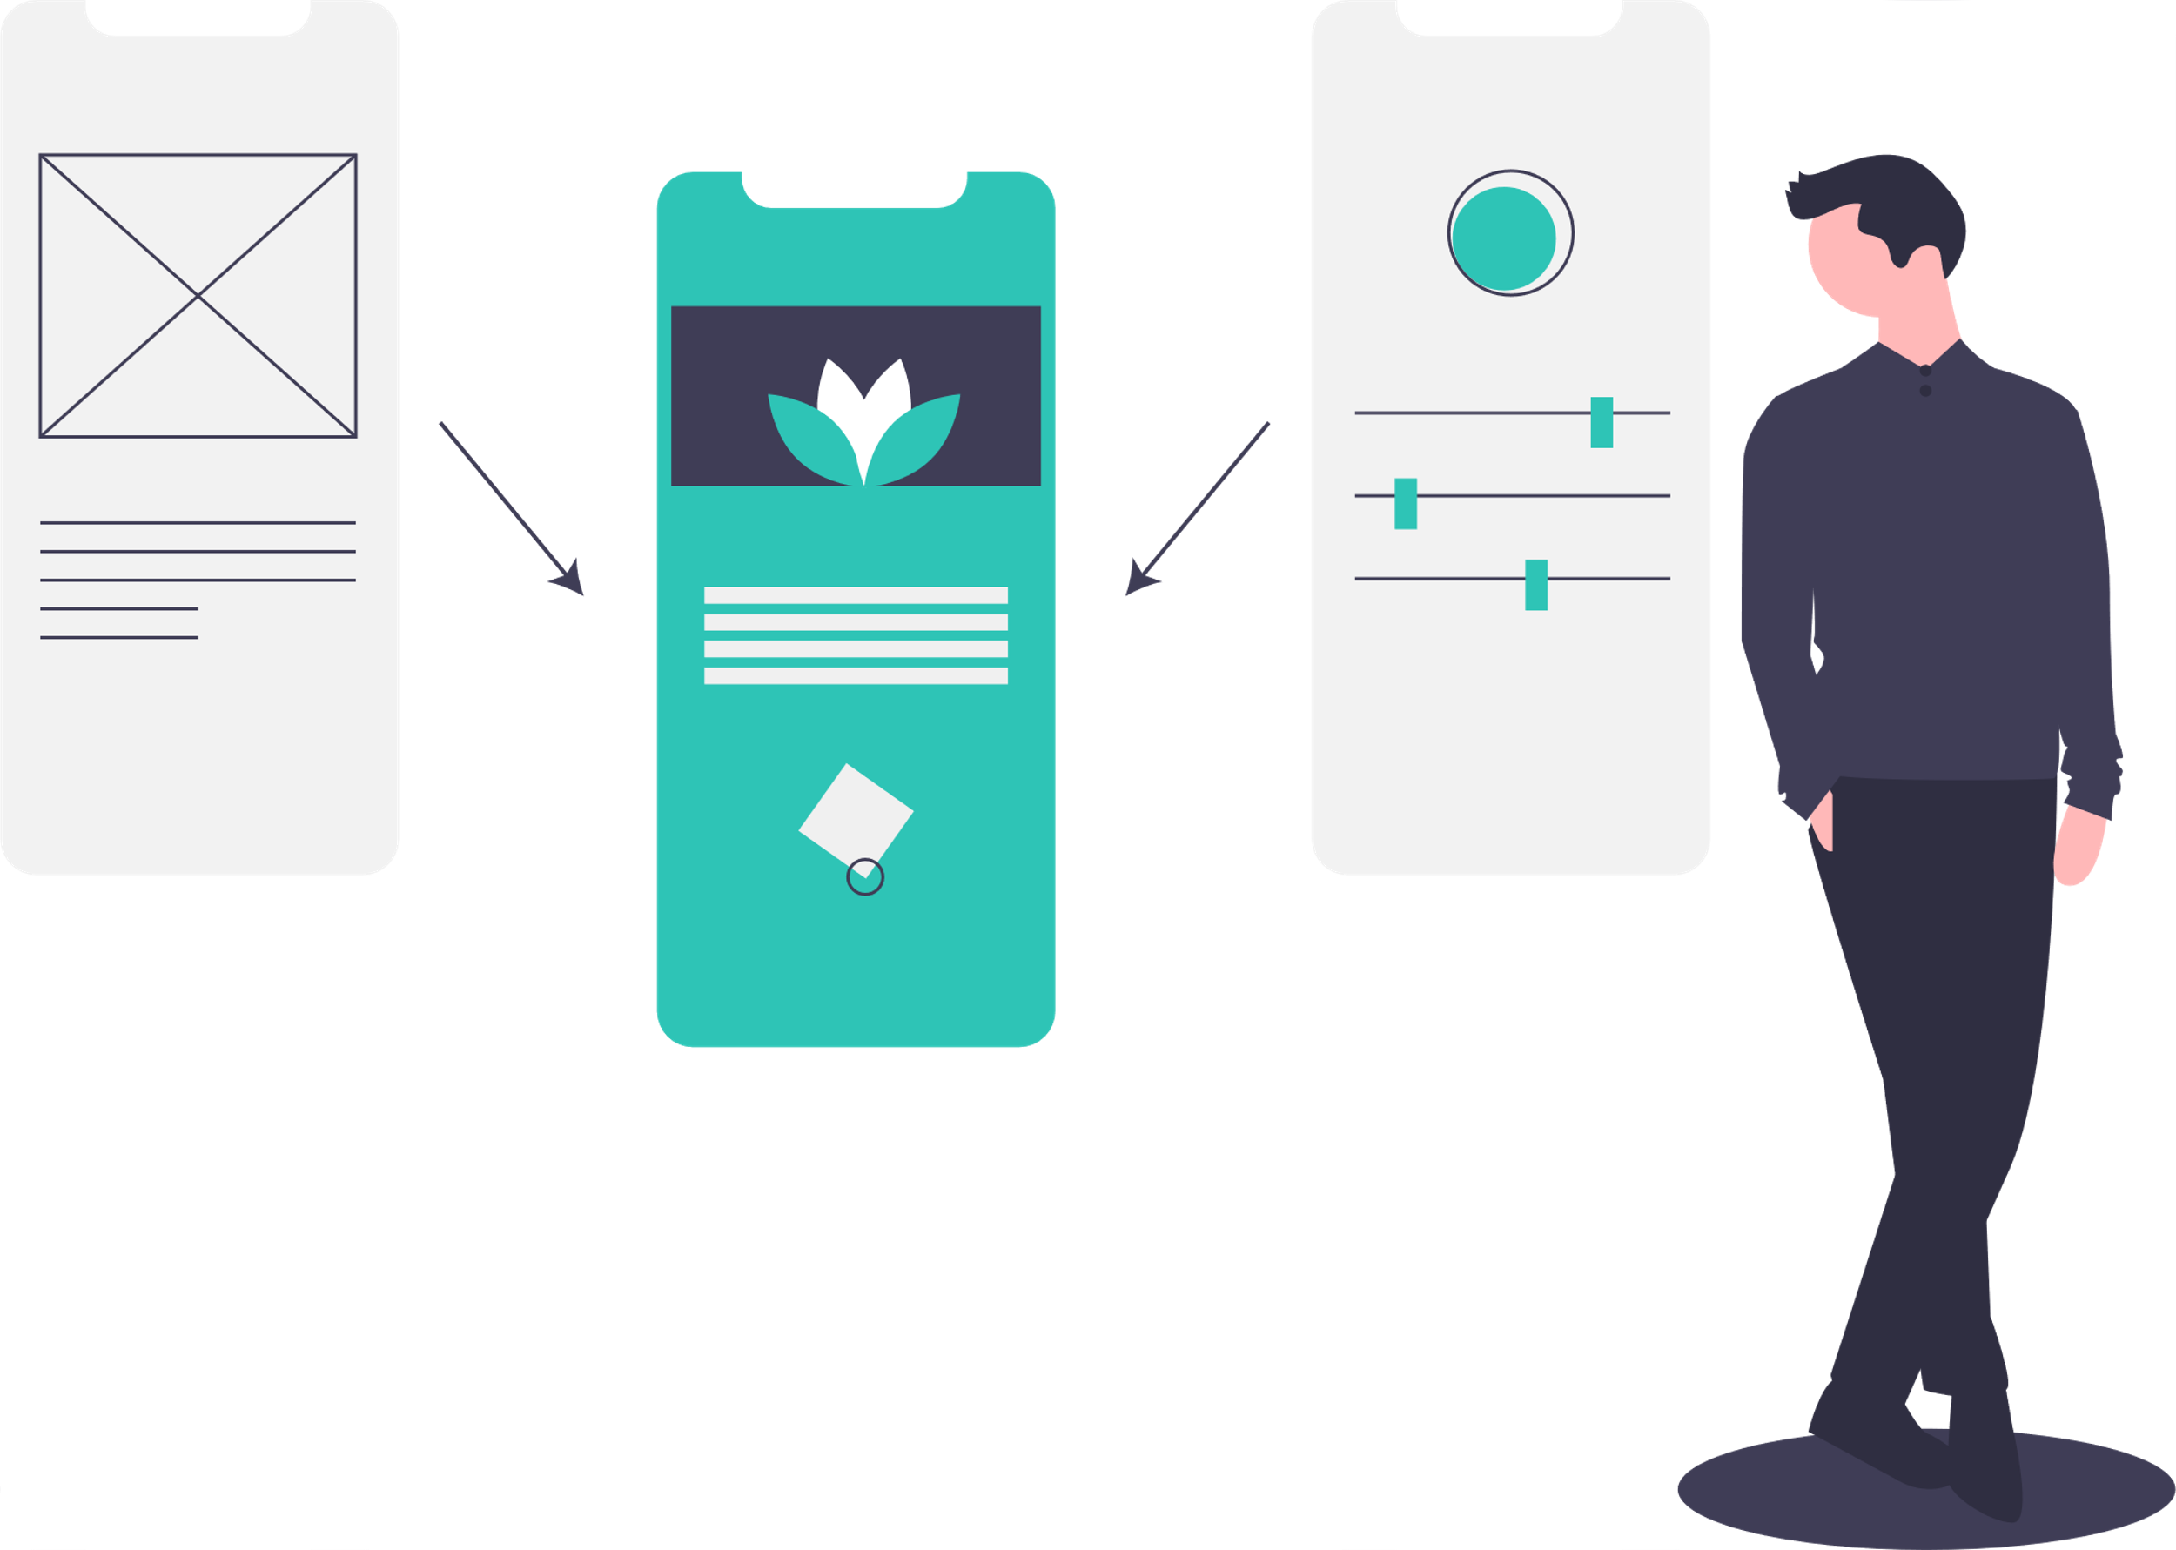
Simple UI
i

Slide 5


Service Within
i
1hour

Slide 6
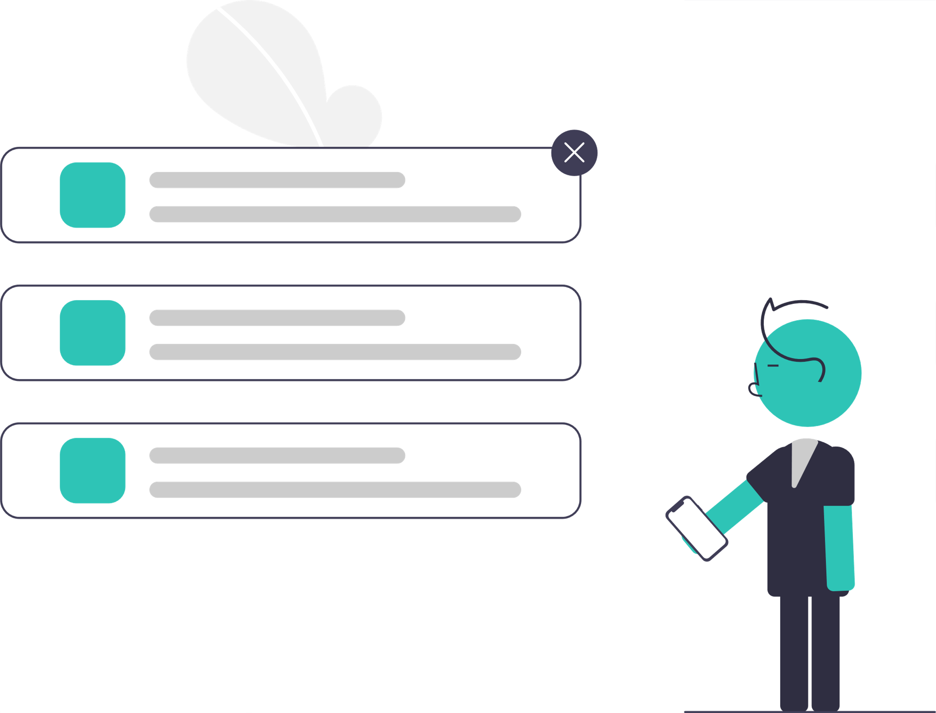


Create multiple appointments/ Medical Tests
i

Slide 7
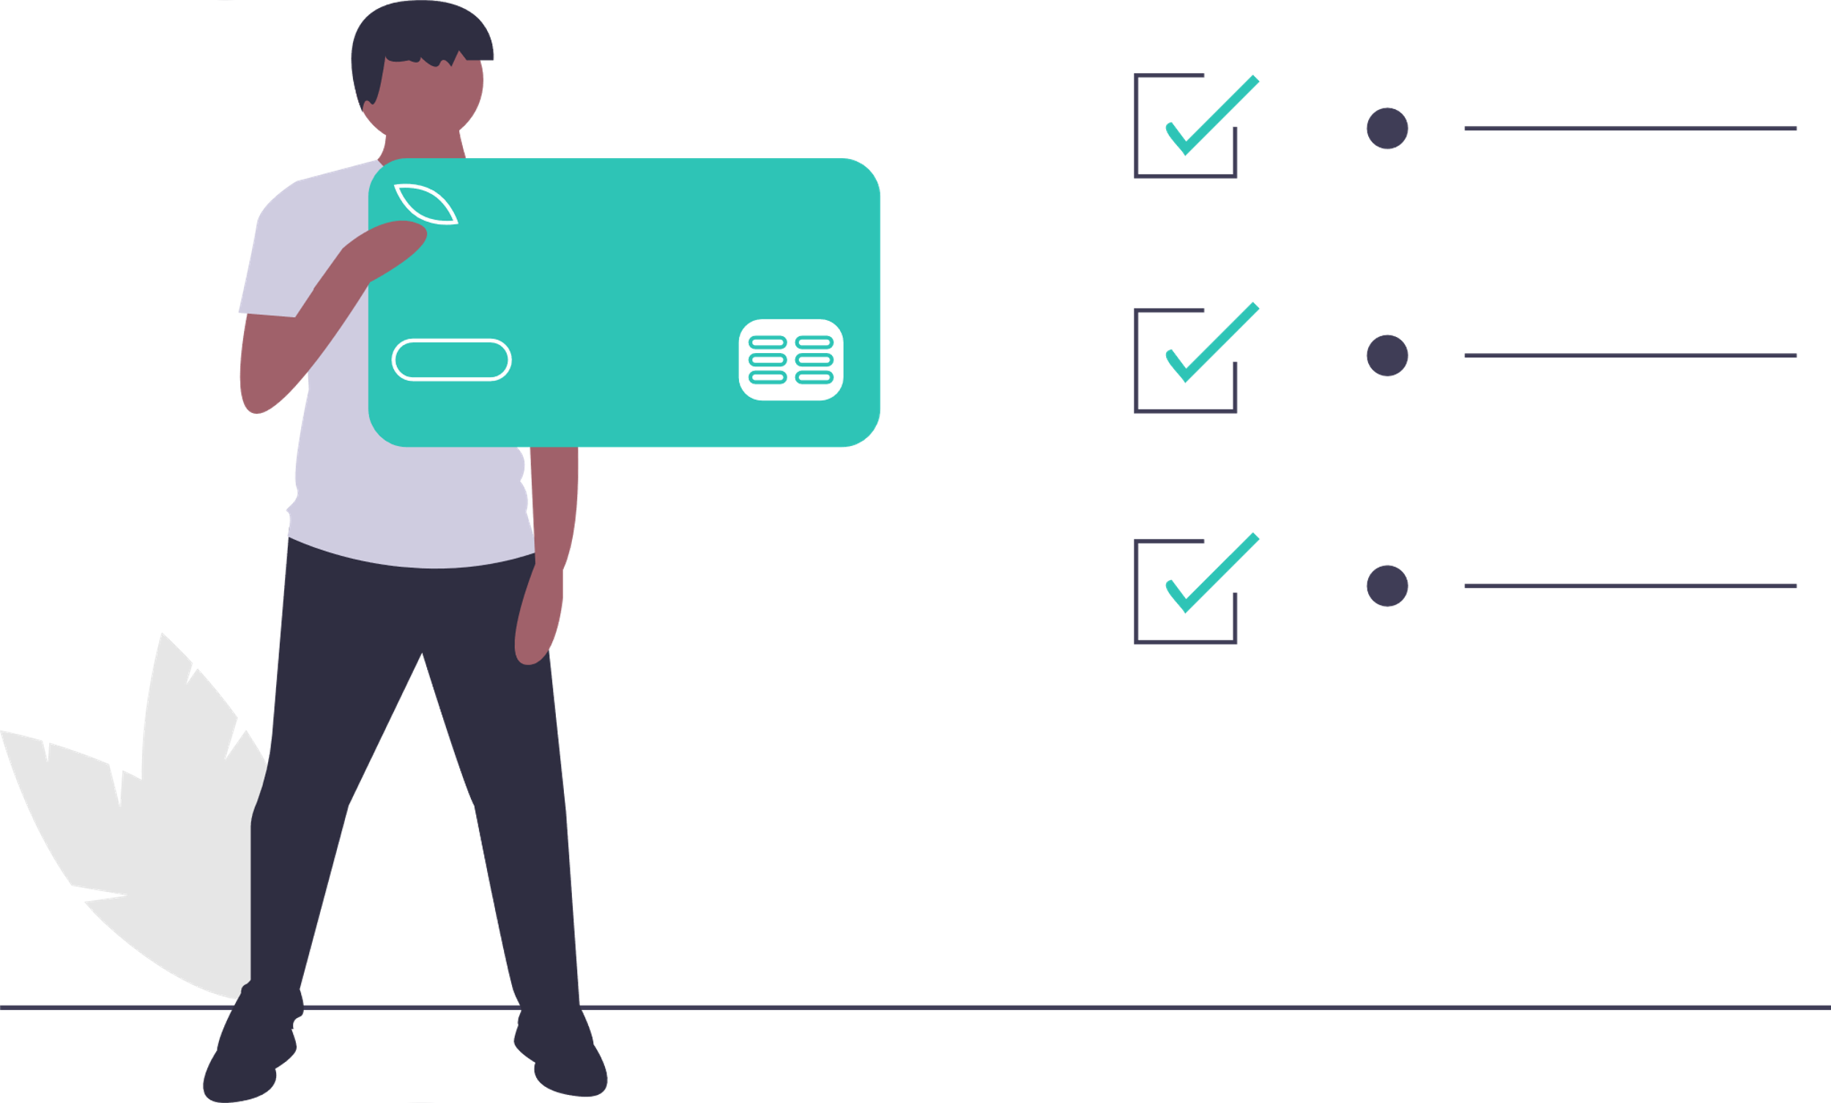
Online Payment
i
Credit Card
Debit Card
UPI
Paytm

Slide 8

Technologies
i
Android : Flutter, Firebase

Slide 9

Availability: Play Store and Website
i

Slide 10

Stay Home Stay Safe

Slide 11
THANKS
FOR LISTENING WITH PATIENCE

